Slide 1
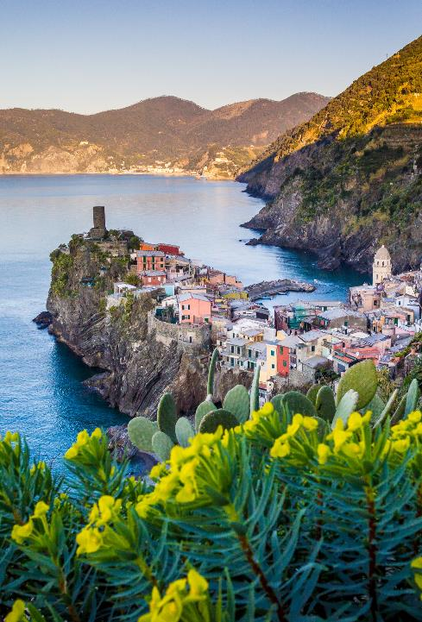
SMART WATER HARVESTING MANGEMENT SYSTEM- final ppt
Team mates :NANDANA RENJITH,DIVYA JAIN,TEJASWINI N,NIMISHA SAHU

Slide 2
Agenda
Problem Statement
Problem solution
3. Furthur scope
4. Tools Used
5. Implemntation and algortithum
6. final result
7. final links

Slide 3
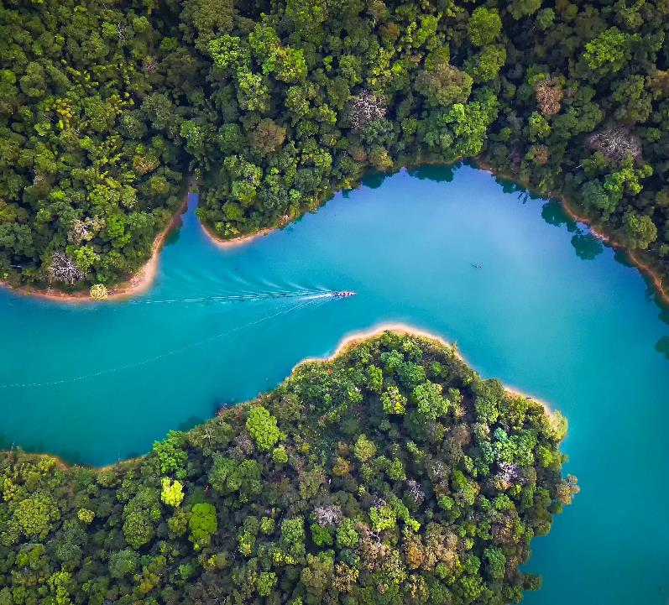
PROBLEM STATEMENT
With increasing urbanization and changing climate patterns, many regions are experiencing inconsistent rainfall and growing water scarcity. Traditional rainwater harvesting systems often operate without data, making them inefficient and difficult to manage.

Slide 4
PROBLEM SOLUTION : SMART WATER MANAGEMENT APP – AQUA MAGE
Urban areas struggle with water scarcity, poor rainwater management, and undetected system inefficiencies like leaks. Traditional methods lack forecasting and data-driven insights. To tackle these challenges, we developed a Smart Rainwater Harvesting Management System as a web-based app. It features rainfall forecasting to anticipate collection opportunities, leak detection based on water level discrepancies, and rainfall data visualization through uploaded CSV files. This solution empowers users with intelligent, real-time tools to improve water conservation, plan efficiently, and ensure system integrity—making rainwater harvesting more sustainable and responsive to changing environmental conditions.
Data visualization:DIvya Jain
Data cleaning and preprocessing :Tejaswini
Data modeling and deployment : Nandana
Documentation : Nimisha

Slide 5
Future Scope
Integration with IoT and Smart Sensors The system can be enhanced by integrating IoT-based sensors for real-time monitoring of water levels, rainfall intensity, and leak detection. This will enable precise automation and timely alerts for efficient water usage.
City-Wide Implementation with GIS Mapping Scaling the system to cover entire communities or urban areas using GIS (Geographic Information System) can help monitor rainwater harvesting efficiency across regions and promote decentralized water management.
AI-Powered Optimization and Weather Prediction Advanced machine learning and deep learning models (like LSTM or GRU) can be used for more accurate rainfall forecasting, optimizing water storage decisions, and predicting usage patterns over time.
Mobile App Deployment and User Personalization Building a mobile app version of the system with personalized dashboards and notifications can empower users to track their water consumption, receive forecasts, and detect issues on the go.
Edge Computing and Sustainability Analytics Incorporating edge computing devices can allow local, real-time data processing, reducing latency and dependency on cloud connectivity. Additionally, sustainability metrics like water savings and CO₂ impact could be tracked.

Slide 6
TOOLS USED
Programming Language
Python – for data analysis, machine learning, and integration.
Libraries & Frameworks
Pandas – for data collection, cleaning, and manipulation.
NumPy – for numerical computations.
Seaborn & Matplotlib – for data visualization and exploratory analysis.
Scikit-learn – for preprocessing (Label Encoding, Min-Max Scaling), model training (RandomForestClassifier), and evaluation (accuracy, confusion matrix, classification report).
ngrok– for saving and loading the trained machine learning model.
Streamlit – for creating the interactive web application interface.
Development & Deployment Tools
Jupyter Notebook (IPython) – for code development and testing.
Streamlit Cloud – for deploying the final application online.
VISUALISATION
TABLEAU: used in visualization of dataset

Slide 7
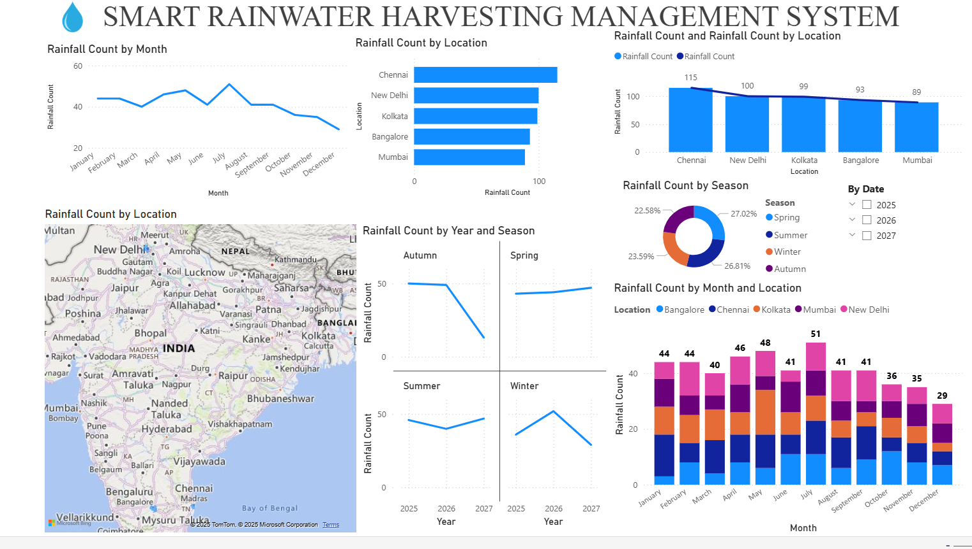
Data visualization
Tools used : Tableau

Slide 8
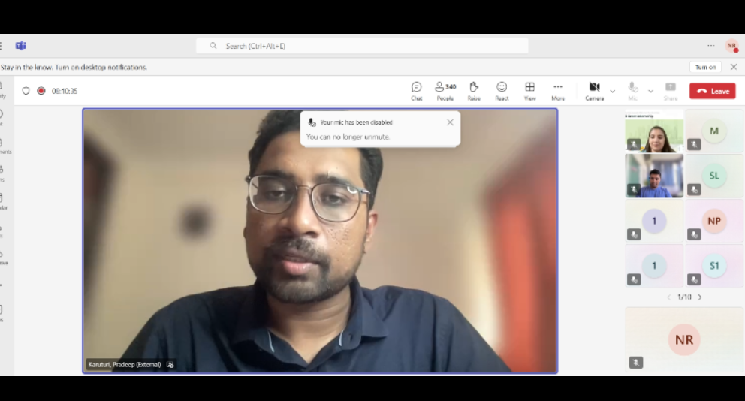
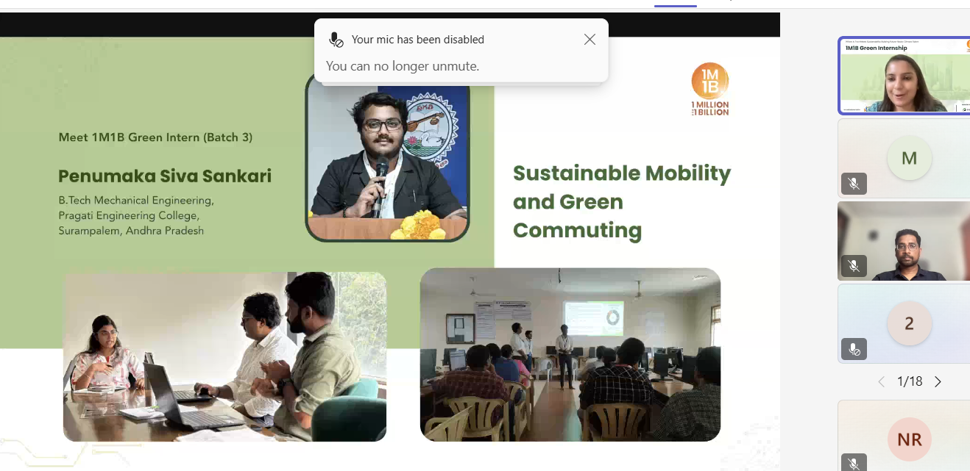
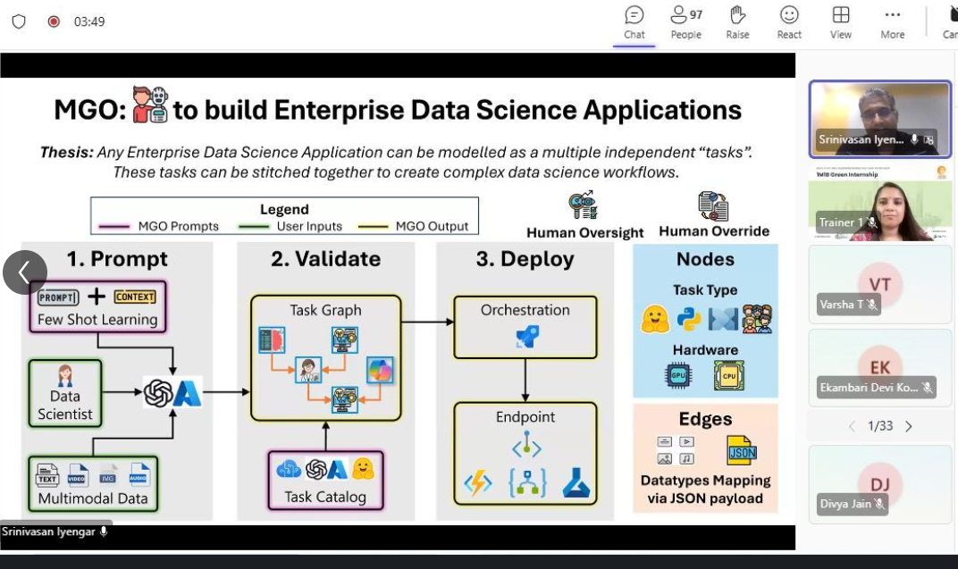
Mentoring sessions

Slide 9
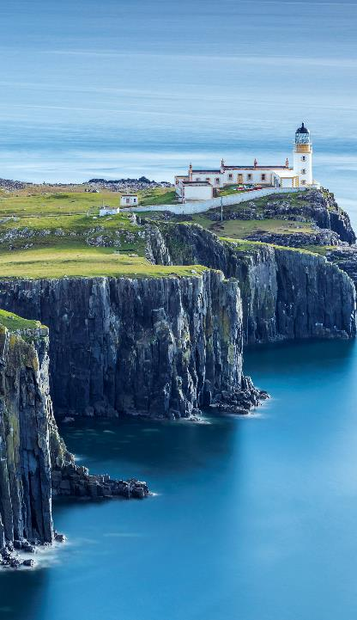
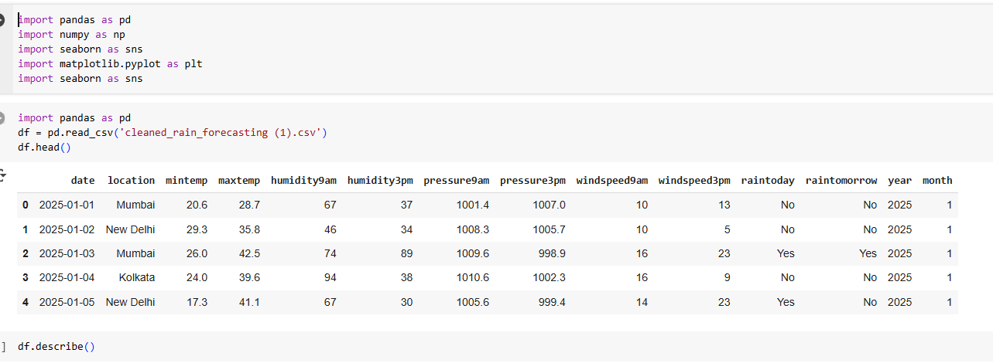
ALGORITHUM AND IMPLEMENTATION
Data Collection
Algorithm
Import required Python libraries.
Load the dataset from a CSV file into a DataFrame.
Display the first few rows to verify successful loading.

Slide 10
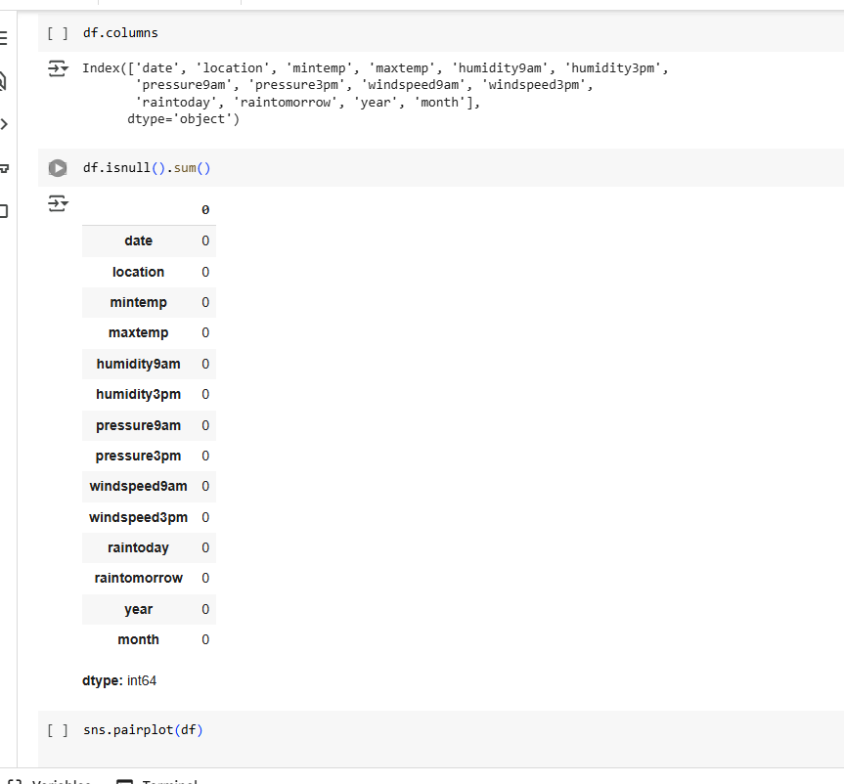
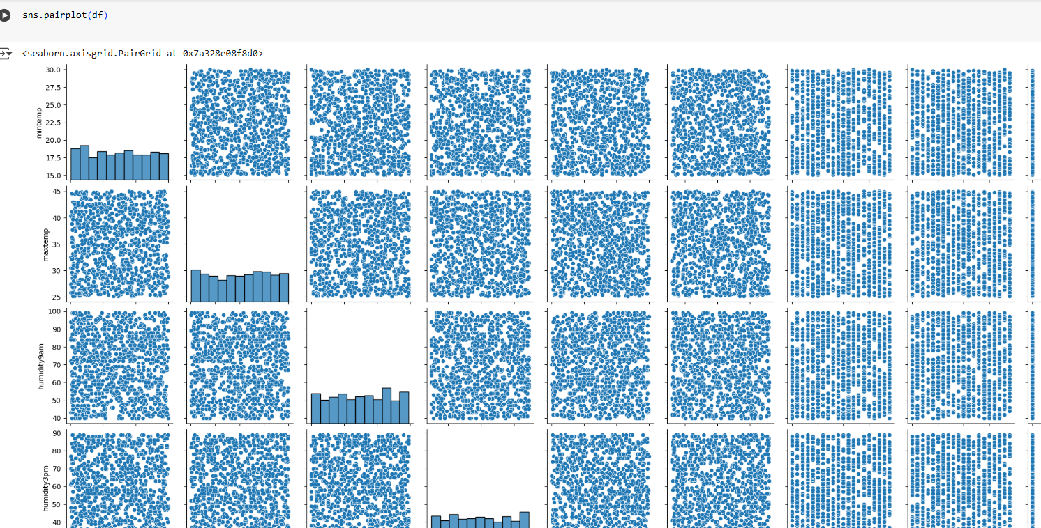
Algorithum and Implementation
. Data Cleaning
Algorithm
Check for missing values in the dataset.
If missing values exist, decide whether to fill them or drop the rows/columns.
Remove duplicate records if any.
Perform basic exploratory analysis to understand data distribution.
Data Preprocessing
Algorithm
Convert categorical variables into numeric form using encoding.
Normalize or scale the data to bring all features to a similar range.
Split the dataset into training and testing sets.

Slide 11
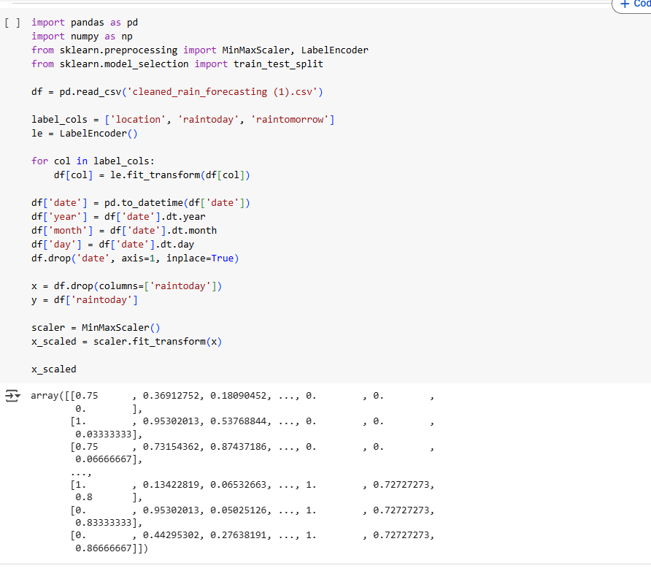
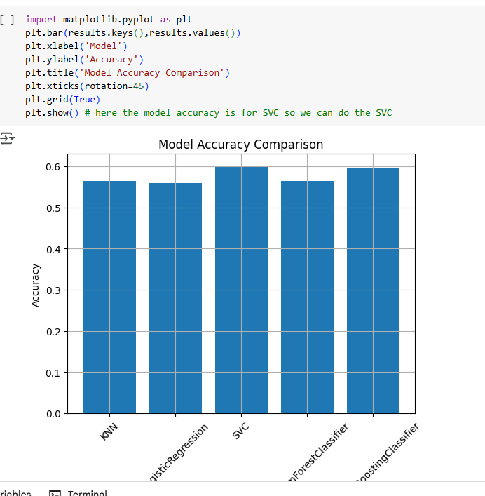
ALGORITHUM AND DEPLOYMENT
Model Selection and Training
Algorithm
Select a suitable ML algorithm (e.g., RandomForest, LogisticRegression, SVCetc).
Fit the model on the training data.
Selected SVC as the accuracy is more
Model Evaluation
Algorithm
Predict on the test data.
Calculate accuracy, confusion matrix, and classification report.
DId a barchart to find out which model is good via accuracy by mathplot lib

Slide 12
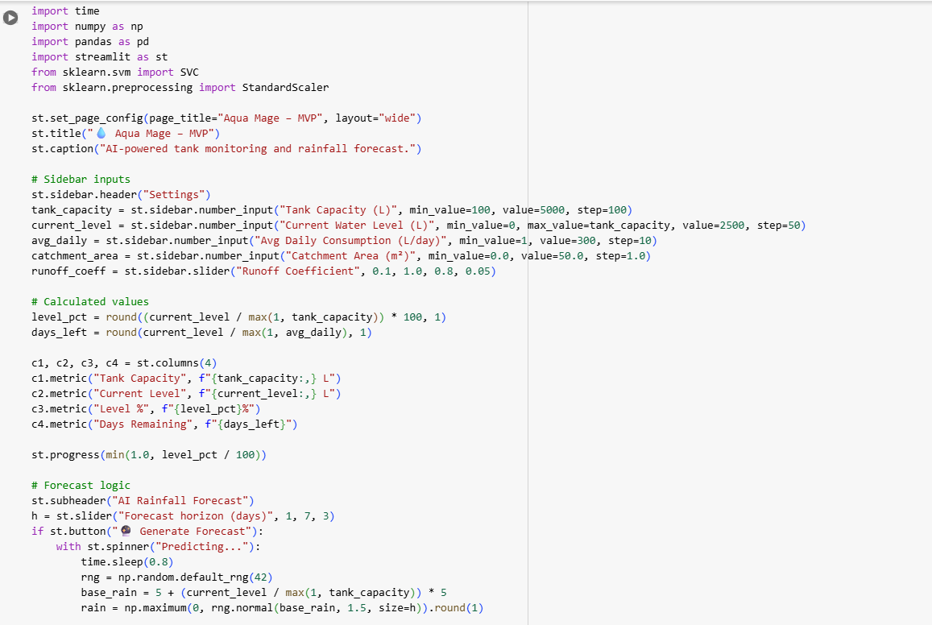
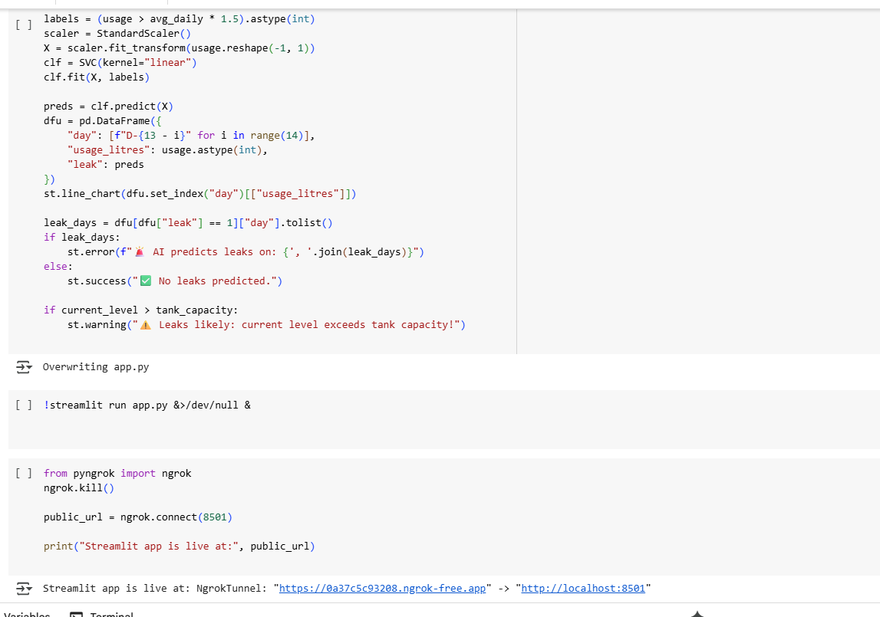
Algorithum and Implementation
Integration with Streamlit
Algorithm
Create a streamlit_app.py file.
Load the trained model.
Create input widgets for user data.
Make predictions based on user input.
Deployment
Algorithm
Save the trained model as a .streamlit file with help of ngrok
Deploy the Streamlit app using Streamlit Cloud or similar service.

Slide 13
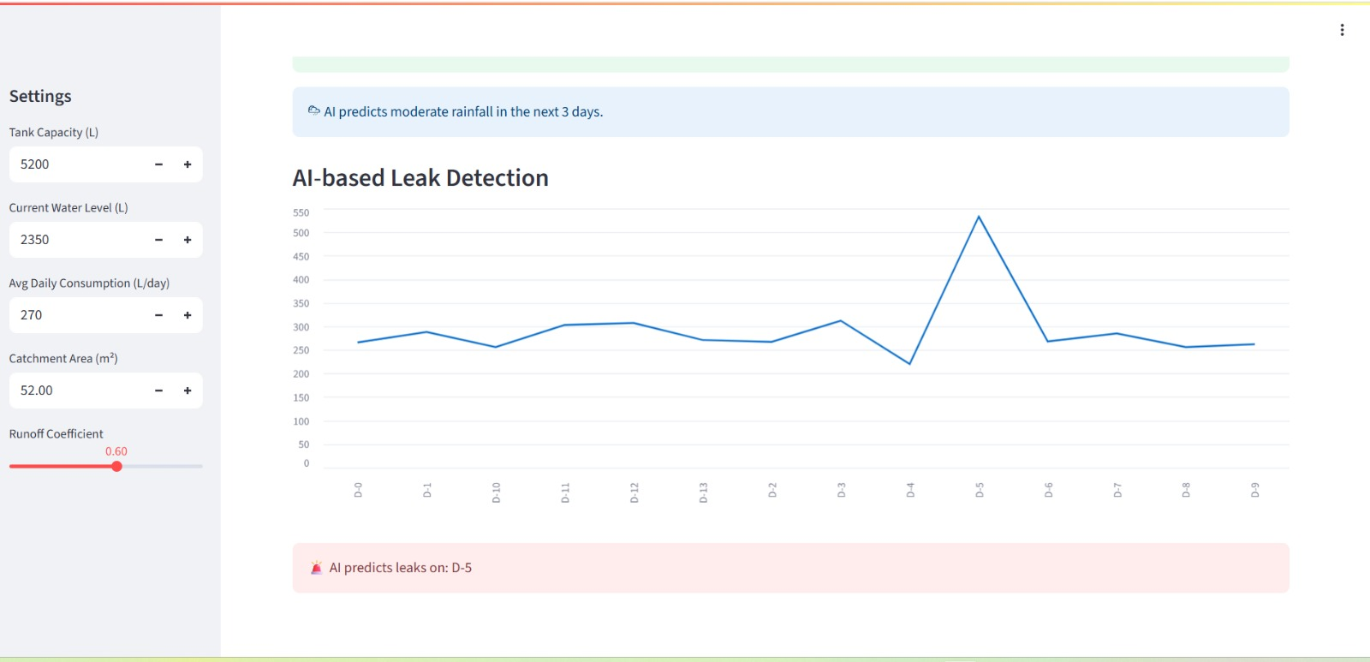
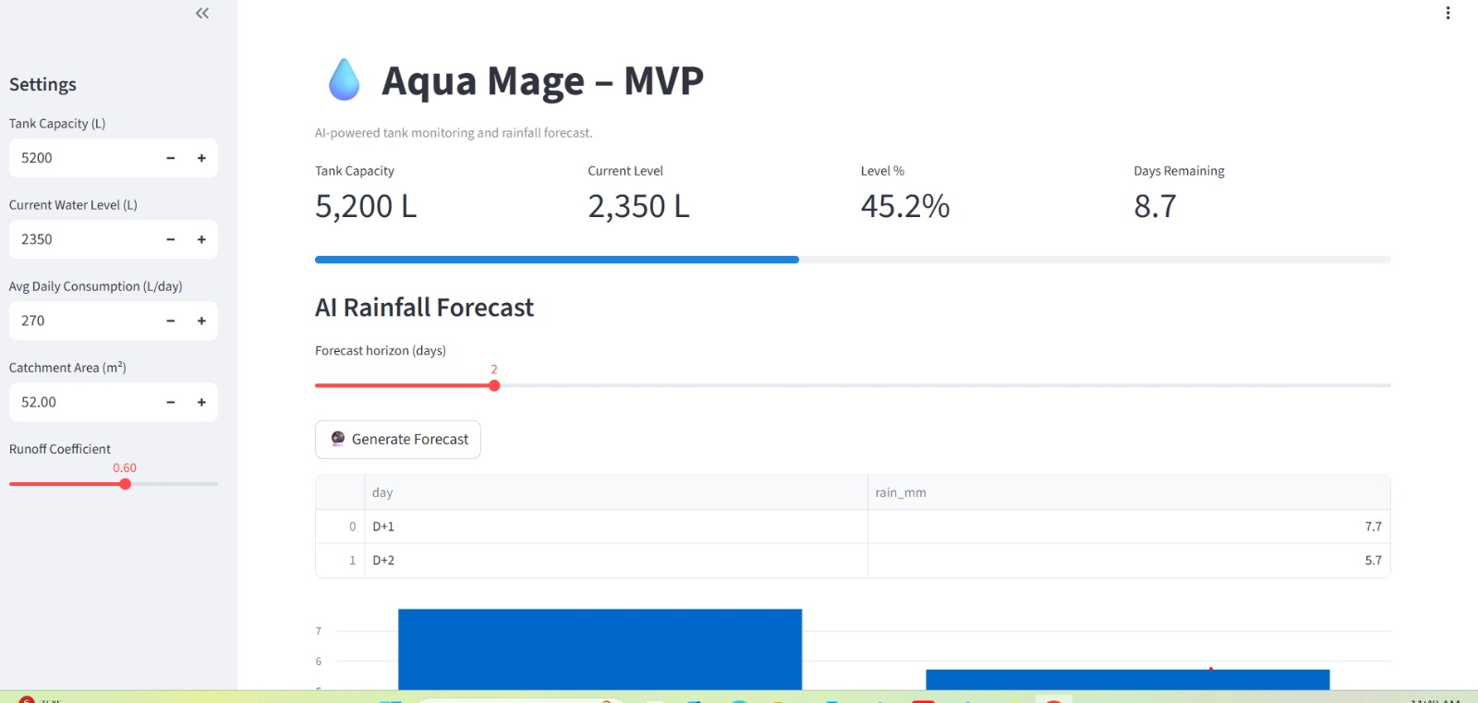
RESULT

Slide 14
Final project
Completed Data visualization and made Dashboards
Collected data
Cleaned the data with the help of pandas
Completed data preprocessing
Completed Data visualization with cleaned dataset
Selected machine learning model for data modeling – SVC
Trained it using SVC – leak detection
Made the UI with streamlit
Deployed it in ngrok

Slide 15
What all we gained by Green Internship by 1M 1B and the smart water conservation system project
WHAT DID WE LEARN FROM GREEN INTERNSHIP AND MENTOR SESSIONS
Gained hands-on experience in applying sustainable technology solutions to real-world environmental problems.
Understood the importance of data-driven decision making for sustainability initiatives.
Learned to analyze environmental datasets and extract insights for conservation and resource optimization.
Developed project planning, collaboration, and time management skills while working in a team.
Strengthened understanding of climate change impacts and the role of innovation in addressing them.
Enhanced problem-solving ability by integrating AI/ML models with sustainability projects.
Improved presentation and communication skills through pitching ideas to mentors and stakeholders

Slide 16

WHAT I LEARNT
WHAT I LEARNT FROM THE CAPSTONE PROJECT (GREEN INTERNSHIP)
Learned how to collect and load real-world environmental datasets (rainfall and weather data) using Pandas.
Understood data cleaning techniques — detecting missing values, removing duplicates, and basic exploratory data analysis using Seaborn visualizations.
Practiced data preprocessing methods like label encoding for categorical features and Min-Max scaling for numerical features.
Gained experience in splitting data into training and testing sets for model evaluation.
Learned machine learning model selection and trained a RandomForestClassifier for rainfall prediction.
Applied model evaluation metrics (accuracy score, confusion matrix, classification report) to assess performance.
Integrated the ML model with Streamlit for creating a user-friendly prediction app.
Learned model serialization using Pickle for deployment purposes.

Slide 17
All video Links and documents for proof
Final Project pitch vedio link :https://drive.google.com/file/d/1D40N7h6W8WJdxxAsH6WdITTL88uabOOa/view?usp=drive_link
Ipynp files link : https://drive.google.com/drive/folders/1OhaO5E73ONcNGA_Rm0SElPuXMVjngsJs?usp=drive_link
Github link: https://github.com/Nandanarenjith/Smart-water-harvesting-management-system
Ground photos link : https://drive.google.com/drive/folders/1XSxb_5cYoOEPO5v8pW-AYlIocWC_kex0?usp=drive_link

Slide 18
Delivering with confidence
"Thousands have lived without love, not one without water." — W. H. Auden

Slide 19

THANKYOU

